Slide 1
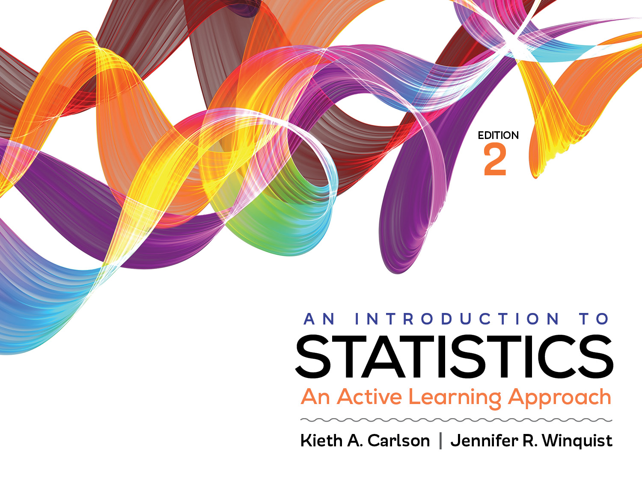
Introduction to Activity 13.1
Correlations

Slide 2
Activity 13.1 will require you to:
Inspect scatterplots to determine if a Pearson’s or Spearman’s correlation is appropriate
Use a scatterplot to estimate the correlation coefficient
Work through all six steps of a correlation hypothesis test by hand and using SPSS

Slide 3
Is amount of chocolate you are given correlated with your happiness? A researcher gave different amounts of chocolate to research participants and then had them complete a happiness questionnaire. Higher scores on the questionnaire indicate greater happiness.
Participant | # of M&Ms | Happiness Score
A | 10 | 2
B | 20 | 3
C | 30 | 3
D | 40 | 5
E | 50 | 6
F | 60 | 6
G | 70 | 8

Slide 4
Step 1: Assess assumptions
Data independence
Appropriate variables
Both interval → Pearson's correlation
At least on ratio → Spearman’s correlation
Normality
Each variable has a normal shape in the population
Scatterplot has
Linear trend→ Pearson’s correlation
Monotonic trend→ Spearman’s correlation

Slide 5
Happiness
Score
# of M&M’s
Reading direction of a correlation from a scatterplot; this is a positive trend.
If trend moves “up-hill” from the left to the right, it is a positive relationship; high scores tend to be paired with other high scores, moderate with moderate, and low with low.
If trend moves “down-hill” from left to right, it is a negative relationship; high scores tend to be paired with low scores on the other variable.

Slide 6
Happiness
Score
# of M&M’s
Reading strength of a correlation from a scatterplot; this is a very strong relationship.
The closer the data points are to forming a “tight” straight line the stronger the relationship between the two variables.
If there is no relationship between the variables the scatterplot would look like a “basketball”; it would have no linear trend at all.

Slide 7
Step 2: State null and research hypotheses
Research Hypothesis
H₁: ρ > 0; there is a positive linear association between amount of chocolate and happiness score
Null Hypothesis
H₀: ρ ≤ 0; there is NOT a positive linear association between amount of chocolate and happiness score

Slide 8
Step 3: Define the critical region
df = N – 2; N = number of paired scores
df = 7 – 2 = 5
Critical value = +.669

Slide 9
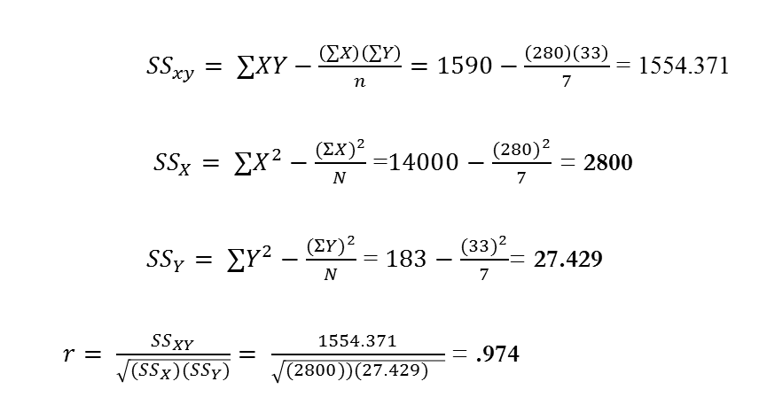
Step 4: Compute statistic
${SS}_{xy}= ∑XY−\frac{\left(∑X\right)\left(∑Y\right)}{n}=1590−\frac{\left(280\right)\left(33\right)}{7}$ = 1554.371
${SS}_{X}= ∑X^{2}−\frac{(Σ{X)}^{2}}{N}$ =$14000−\frac{(280)^{2}}{7}$ = 2800
${SS}_{Y}= ∑Y^{2}−\frac{(Σ{Y)}^{2}}{N}$ = $183−\frac{(33)^{2}}{7}$= 27.429
$r= \frac{{SS}_{XY}}{\sqrt{({SS}_{X}{)(SS}_{Y})}}= \frac{1554.371}{\sqrt{(2800){)(27.429)}_{}}}$ = .974
# of M&Ms (X) | Happiness Score (Y)
10 | 2
20 | 3
30 | 3
40 | 5
50 | 6
60 | 6
70 | 8

Slide 10
Step 5: Compute effect size
r² = .949

Slide 11
Step 6: Summarize results
There was a significant positive correlation between number of M&Ms given to participants and their happiness scores, r (5) = .97, p < .01.

